Slide 1
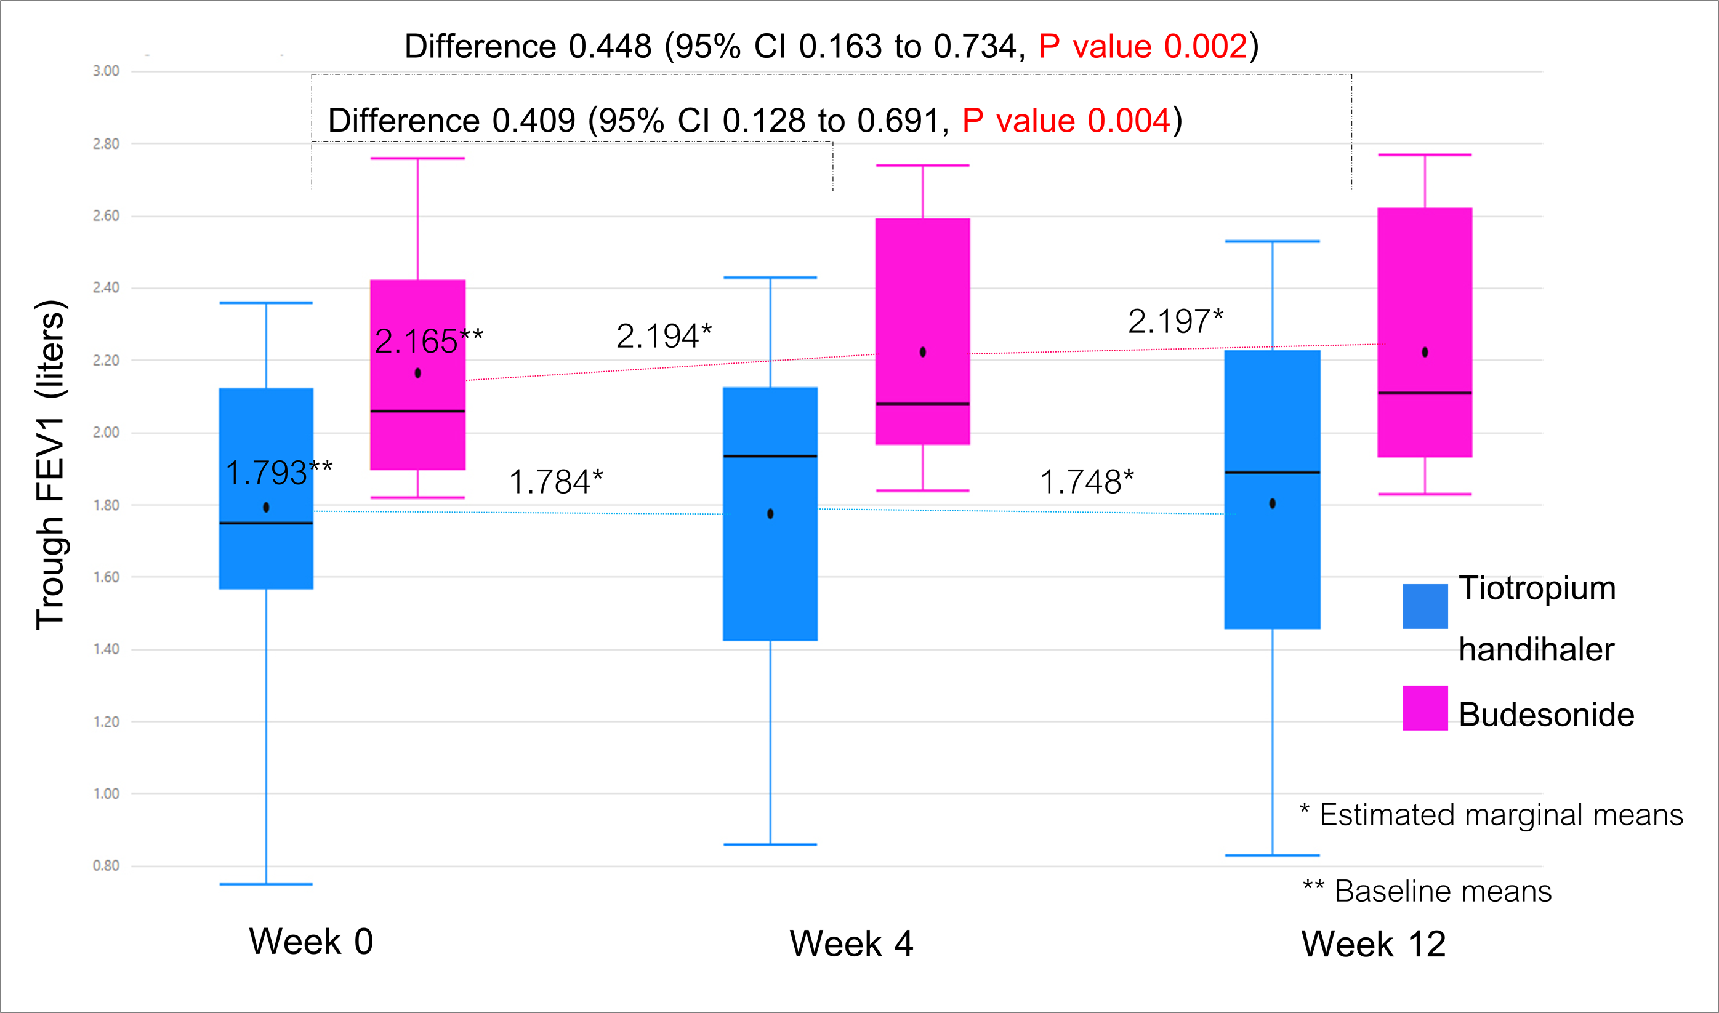
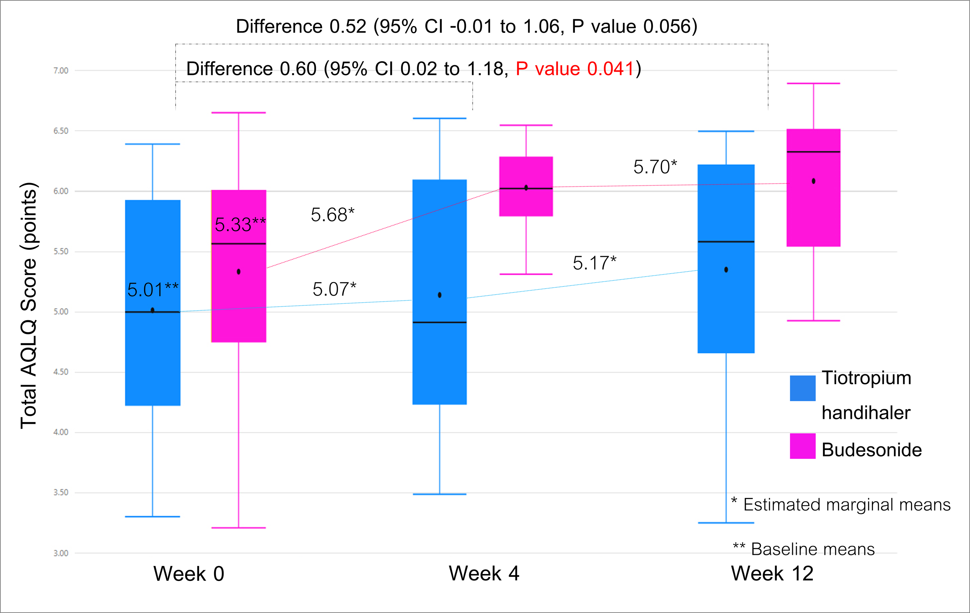
Table: Mean difference in change of outcomes from baseline at 4 and 12 weeks
Efficacy of add-on tiotropium handihaler versus add-on budesonide in asthma patients who previously on ICS/LABA
Witchaya Aunanan M.D¹, Thitiwat Sriprasart M.D¹
¹Division of Pulmonary and Critical Care Medicine, Department of Medicine, Faculty of Medicine,
Chulalongkorn University, Bangkok, Thailand
Outcomes | Mean difference in change from baseline between Bud and Tio (95% CI )
 | At 4 weeks | P-value (2-tailed) | At 12 weeks | P-value (2-tailed)
Primary outcomes
Post-bronchodilator trough FEV1 - liters | 0.409 (0.128 to 0.691) | 0.004 | 0.448 (0.163 to 0.734) | 0.002
Secondary outcomes
ACT score – points | 1.80 (-0.49 to 4.09) | 0.124 | 1.75 (-0.48 to 3.98) | 0.124
AQLQ score – points
▪ Total AQLQ score | 0.60 (0.02 to 1.18) | 0.041 | 0.52 (-0.01 to 1.06) | 0.056
▪ Symptom | 0.59 (-0.01 to 1.19) | 0.054 | 0.46 (-0.09 to 1.02) | 0.101
▪ Activity limitation | 0.39 (-0.09 to 0.89) | 0.112 | 0.63 (0.18 to 1.07) | 0.005
▪ Emotional function | 0.54 (-0.25 to 1.35) | 0.183 | 0.42 (-0.30 to 1.15) | 0.251
▪ Environmental stimuli | 0.88 (0.13 to 1.63) | 0.021 | 0.59 (-0.06 to 1.24) | 0.075
FeNO - ppb | - | - | -15.76 (-29.06 to -2.45) | 0.023
Background: GINA recommends increasing inhaled corticosteroid (ICS) or add-on tiotropium respimat (TioR) to control asthma at step 4 and 5. In Thailand, tiotropium handihaler (Tio) is cheaper and more available than TioR.
The evidence of comparing the efficacy of add-on Tio and increasing dose of ICS in asthma patients previously on inhaled corticosteroid and long acting β2 agonist (ICS/LABA) is limited. We, therefore, compared the efficacy of these two drugs.
Methods: This is a randomized controlled trial. We enrolled asthma patient, 18 to 75 years, and on at least moderate dose of ICS/LABA. Each patient was randomly assigned to receive Tio (18 mcg/day) or Budesonide (Bud 400 mcg/day). The primary outcome was the difference of improvement of trough forced expiratory volume in 1 second (FEV1) at 4 and 12 weeks between two groups. The secondary outcomes were Asthma Control Test (ACT) and Asthma Quality of Life Questionnaire (AQLQ) at 4 and 12 weeks and fractional exhaled nitric oxide (FeNO) at 12 weeks.
Results: Total 25 patients were enrolled. All patients were type 2 inflammation. There were 11 and 14 patients in Bud and Tio group, respectively. Bud was superior than Tio in improvement of FEV1, with the mean difference in change from baseline at 4 and 12 weeks of 0.409 liters (95% CI 0.128 to 0.691, P value 0.004) and 0.448 liters (95% CI 0.163 to 0.734, P value 0.002), respectively. There was no statistical difference in the change of mean ACT score between two groups. Bud was statistically superior than Tio in improvement of total AQLQ score at 4 weeks, with values of 0.60 points (95% CI 0.02 to 1.18, P value 0.041). But there was no statistical difference in term of improvement of total AQLQ score at 12 weeks. Bud was statistically superior than Tio in reducing FeNO level at 12 weeks, with value of -15.76 ppb(95%CI -29.06 to -2.45, P value 0.023).
Figure: Mean difference in change of trough FEV1 and total AQLQ score from baseline
Conclusions: Increasing dose of ICS to treat asthma patients, who previously on moderate or high dose ICS/LABA and type 2 inflammation phenotype, was superior than add-on Tio in improvement of FEV1 and the patients’ quality of life. The efficacy of increasing dose of ICS or add-on Tio in non type2 asthma needs to be explored.
Key words: Add-on budesonide, Add-on tiotropium handihaler, Asthma treatment

